Slide 1


Using Copilot Pro with Microsoft Excel
Notes:
https://copilot.cloud.microsoft/en-US/copilot-excel

Slide 2




Notes:
https://www.youtube.com/channel/UC35ZpwldGw7ZJ5R-2sLijzw

Slide 3


Membership has its privileges
Notes:
https://www.youtube.com/channel/UC35ZpwldGw7ZJ5R-2sLijzw/join

Slide 4

“Nobody sets out to create a mission critical spreadsheet, they ‘just happen’. ”
-Felienne Hermans in “Analyzing and Visualizing Spreadsheets”

Slide 5

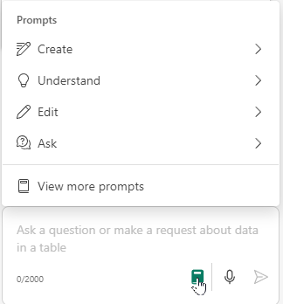
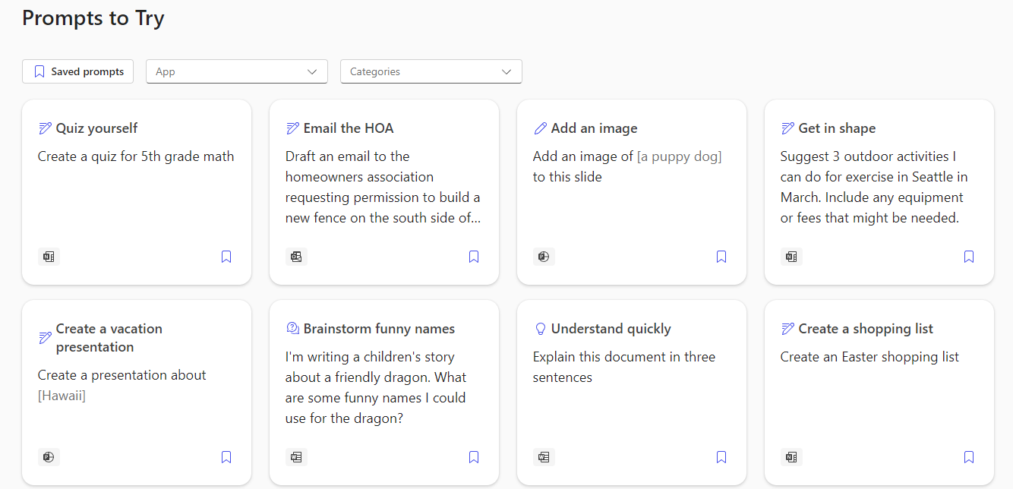
Notes:
https://copilot.cloud.microsoft/en-US/prompts/all

Slide 6
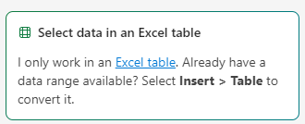
Make Sure you are in a cell of the data

Slide 7

Ask Questions About the Data
Notes:
What is this spreadsheet about?
How many products do we sell?
Show total sales for each product.
How much profit did we make in America by year?

Slide 8

Highlight, Sort, and Filter
Notes:
Highlight the top 10 sales in the sales column.
Sort from highest to lowest sales.
Show only profit over 100k.

Slide 9

Adding New Columns (formulas)
Notes:
Add a "Percentage Profit" column that shows the percent difference between "Gross Sales" and "Profit“
Give me a column that shows the percentage of gross sales that are eaten up by cogs.
Add a column that calculates the number of days from the sales date to today.

Slide 10

Create graphs and charts
Notes:
Give me a good looking chart that clearly shows profit over time
Make a donut chart out of sales by product
Plot sales for Carretera and Paseo over time
Create a scatter plot of manufacturing price vs gross sales

Slide 11


